Slide 1
Group 1 | Group 2 | Group 3
Villagers will stay at their “home” and trade post-its with the traders who travel though. Villagers will add trader stickers to their home posters. Traders will travel to the other locations, and trade post-its with the villagers. | Villagers Traders | Villagers Traders
What do you notice about how the posters started versus how they ended up? | What do you wonder about this activity? | What do you think the post-its represent in this activity?
Cue to Move: mi re mi - la so la - mi so mi re do

Slide 2
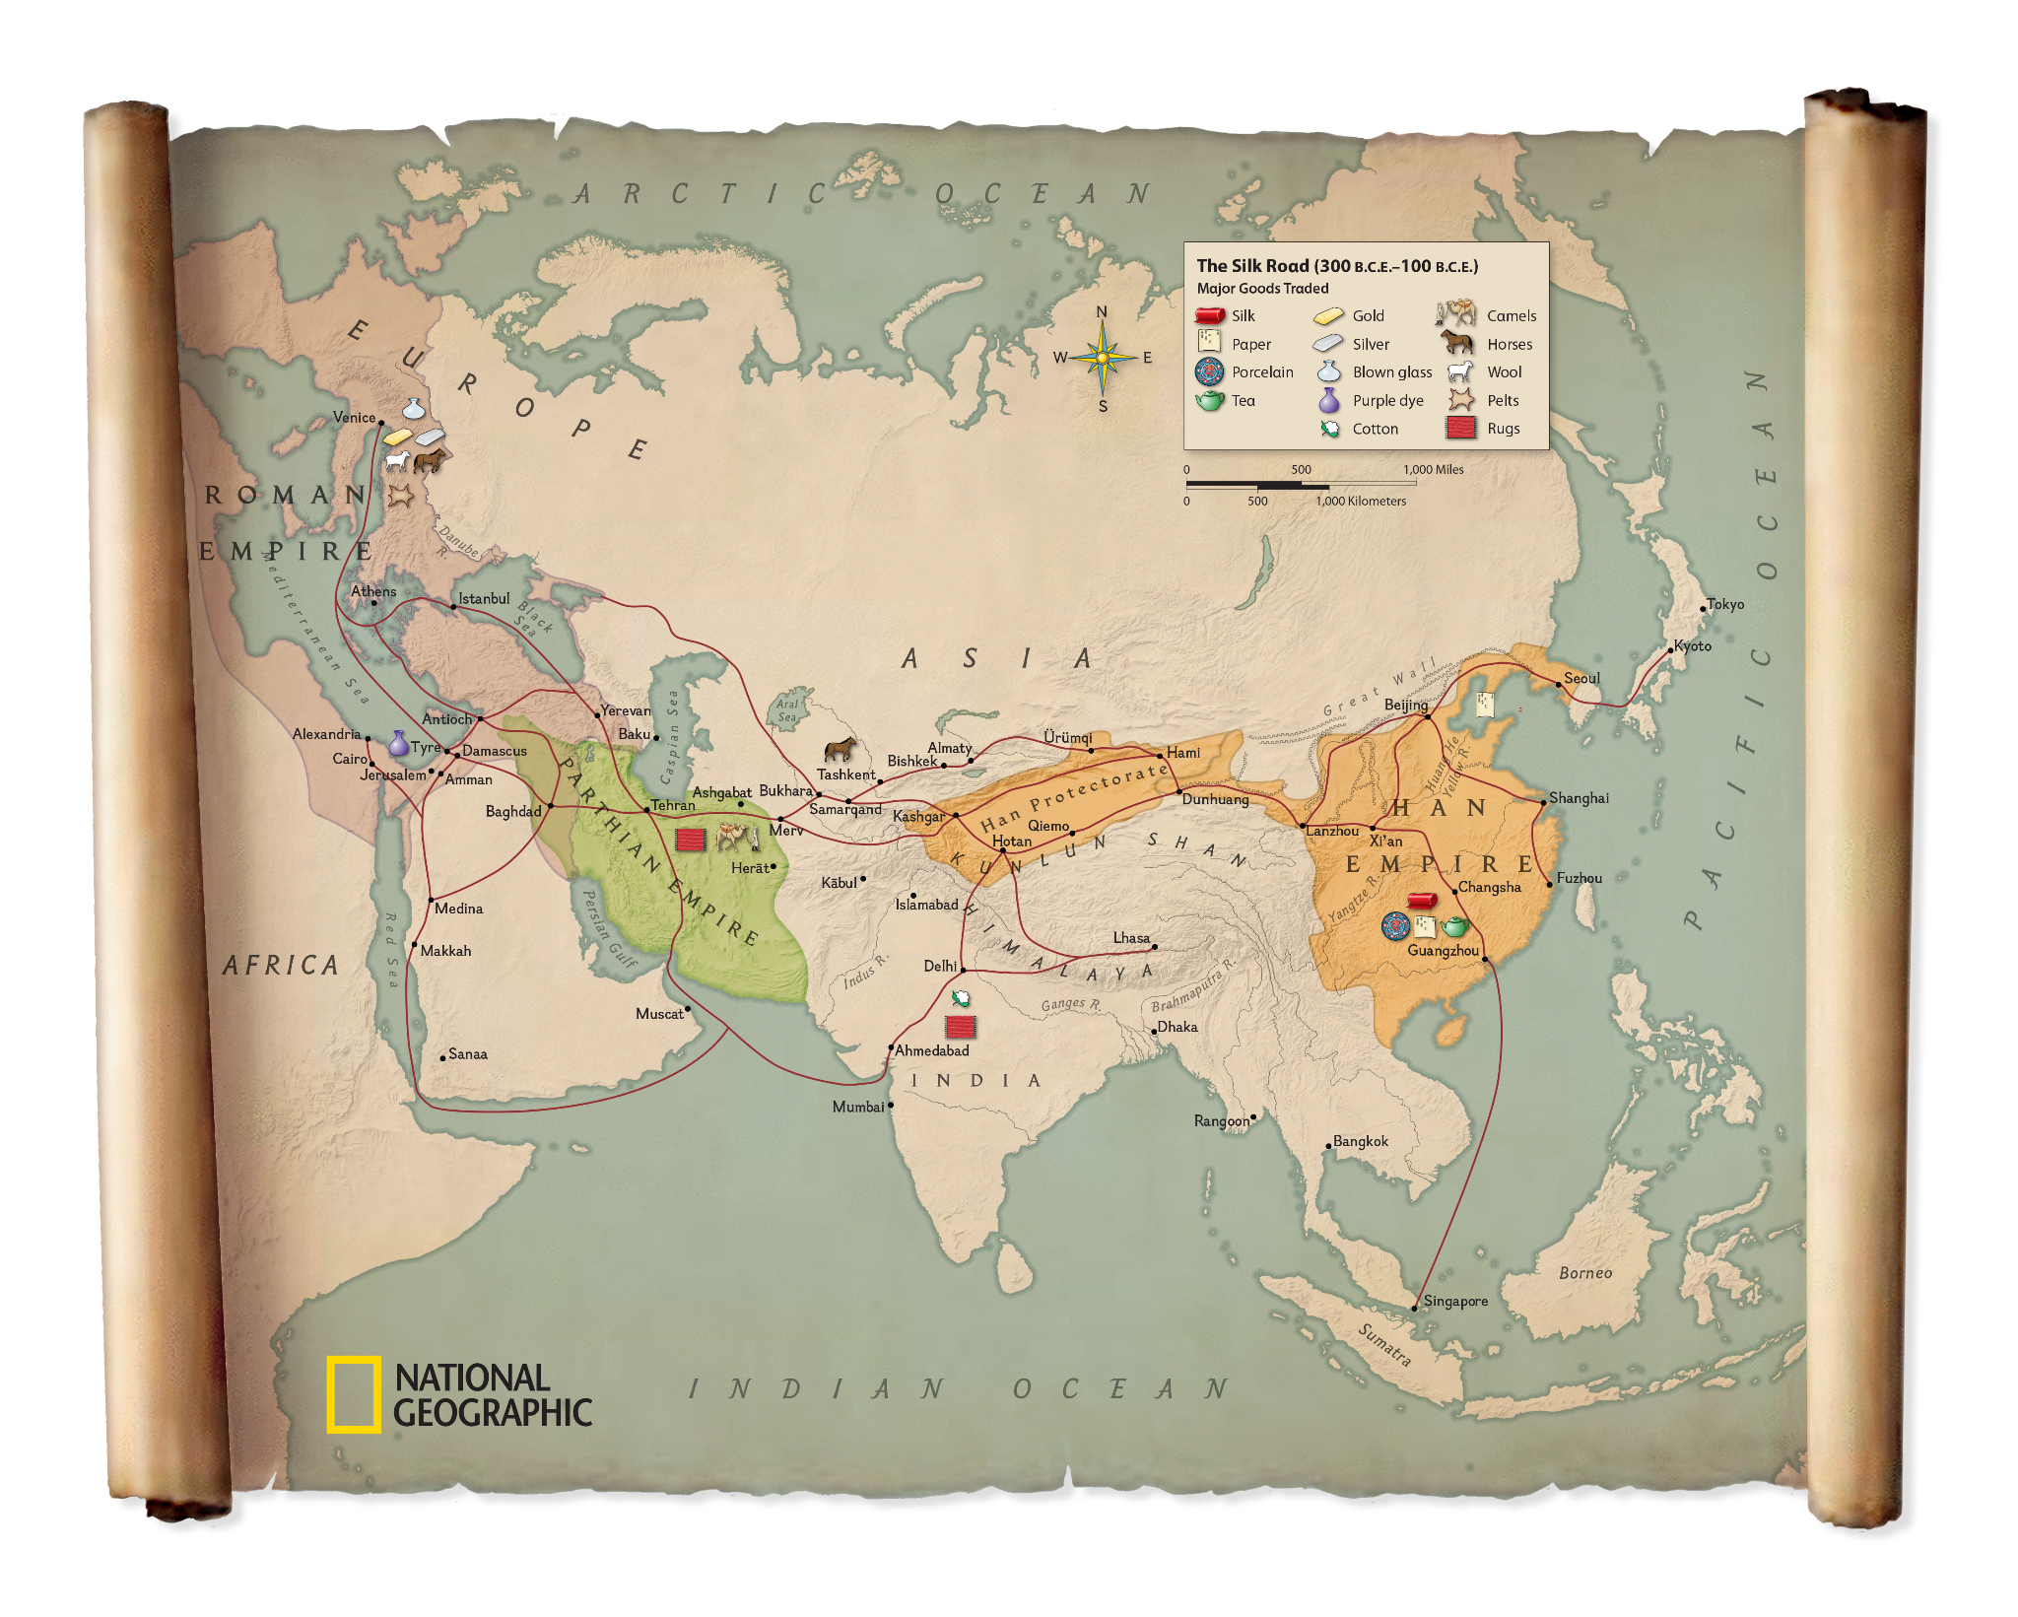
The Silk Road
Tang Dynasty (618–907)
NOT one singular road, but a network of trade routes over land and sea
Exchange of physical objects, but also culture, languages, and even music.

Slide 3
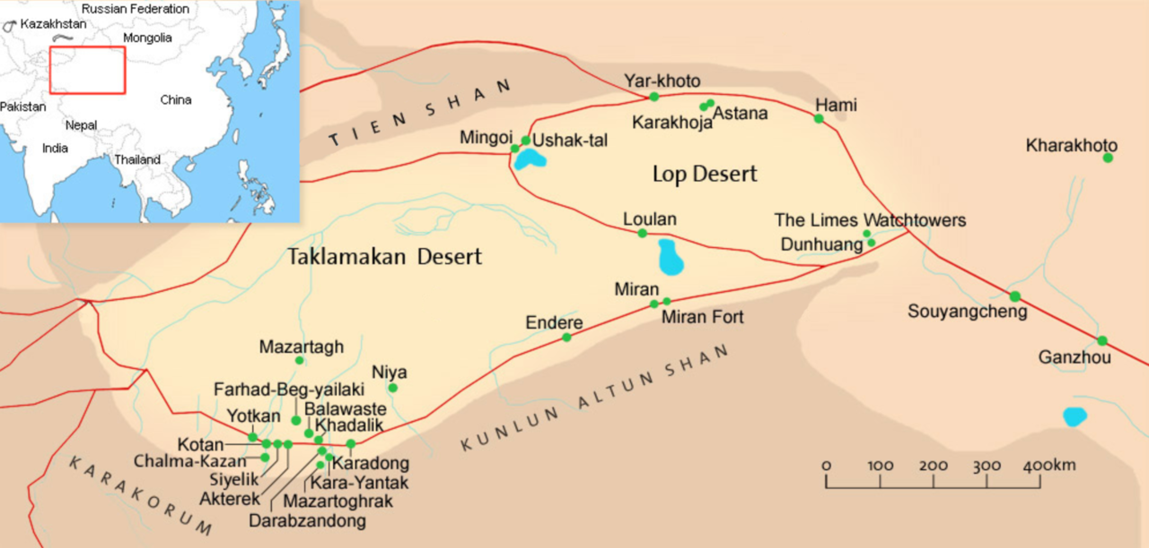

Slide 4
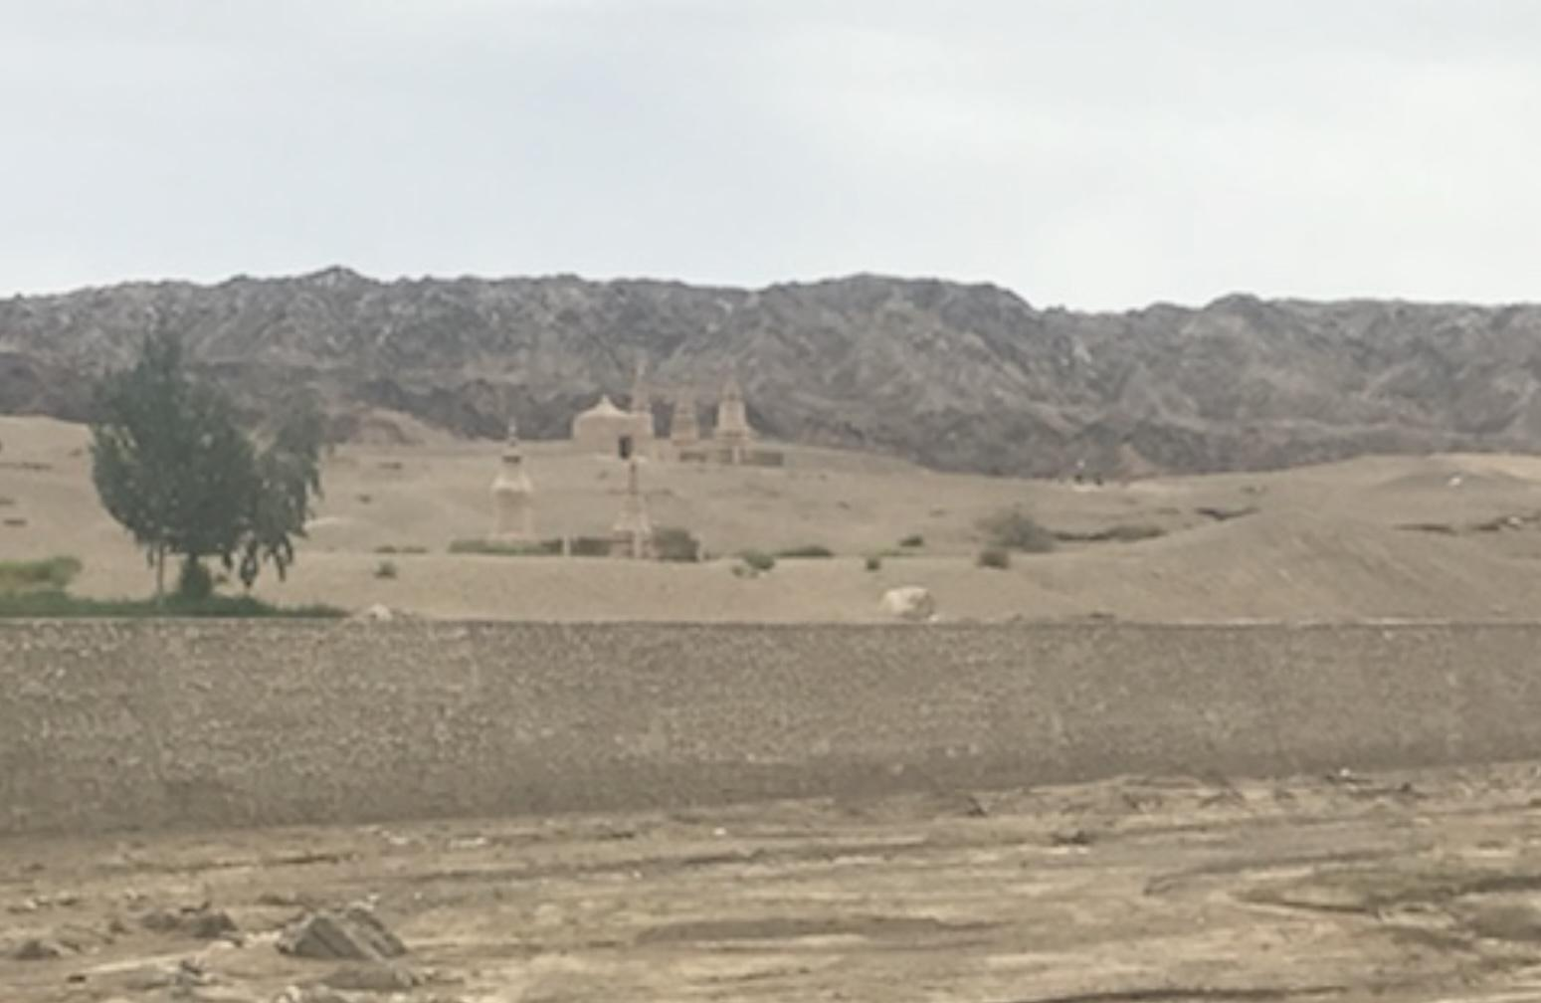
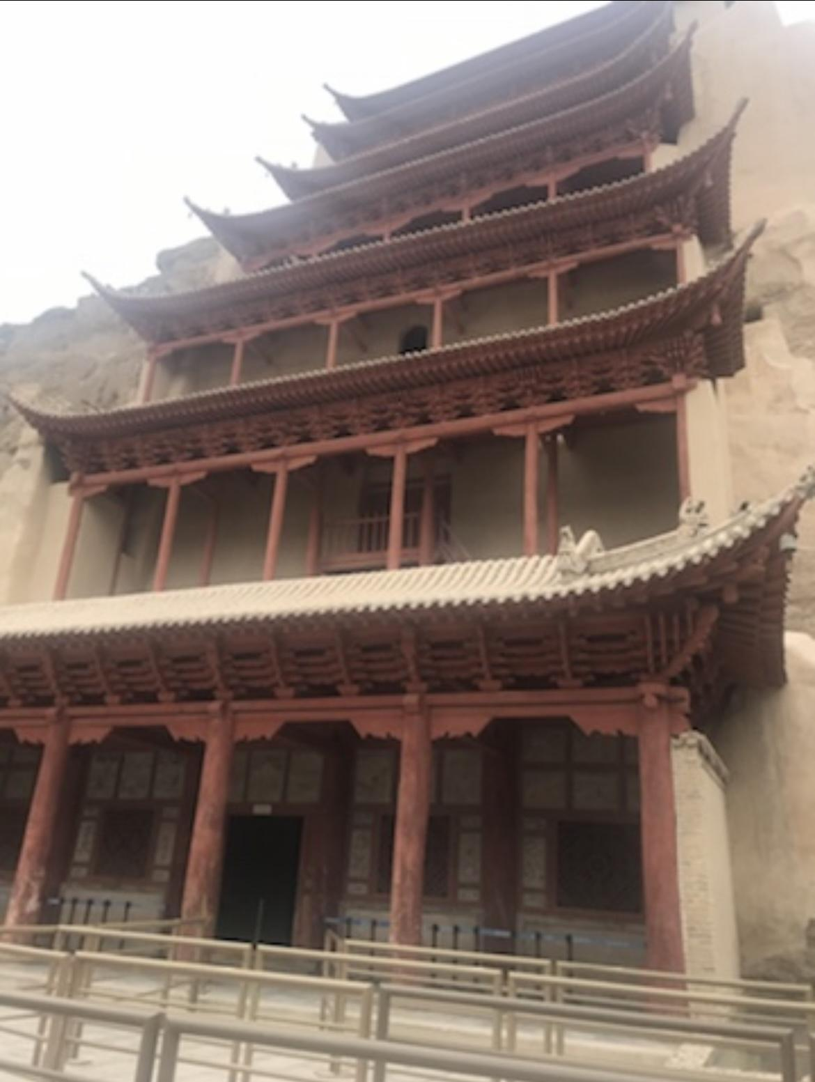
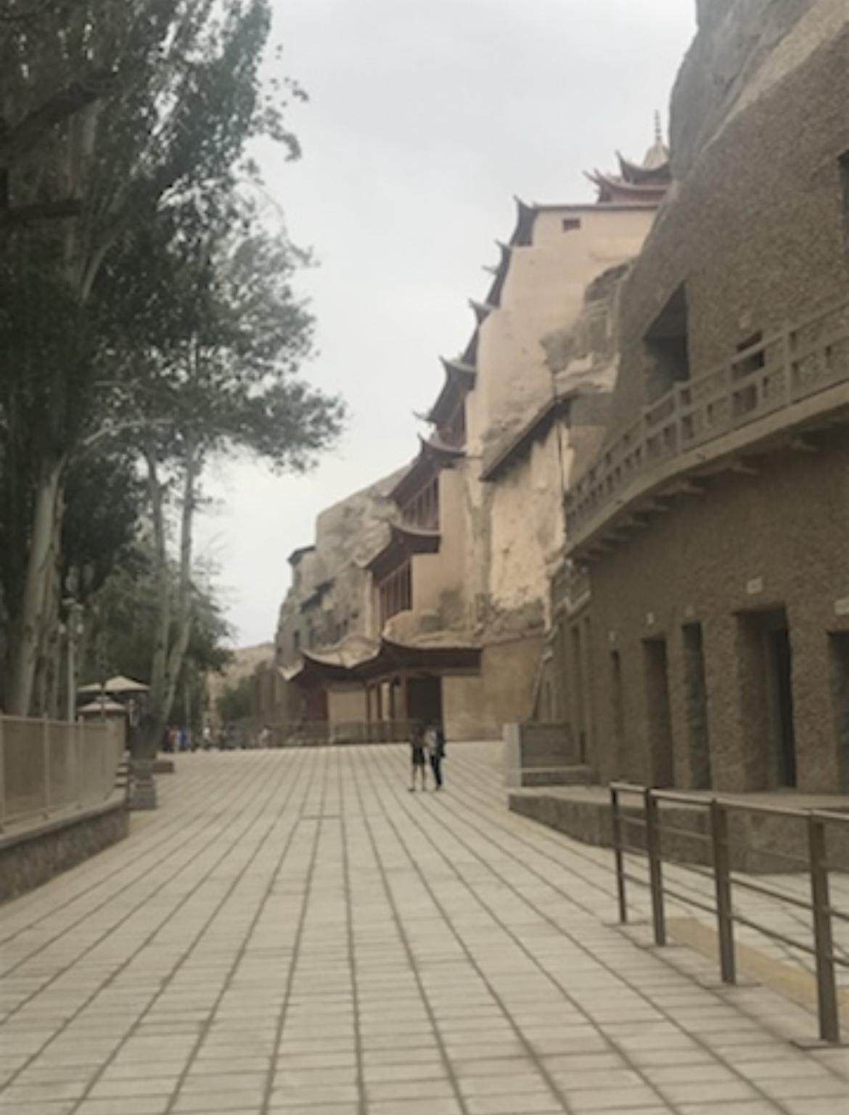

Slide 5
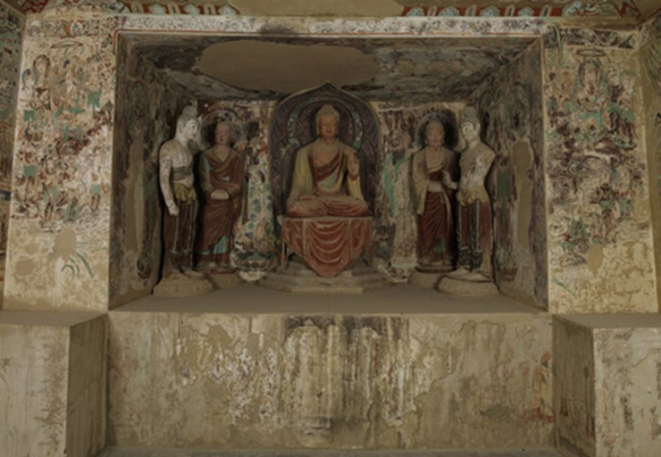
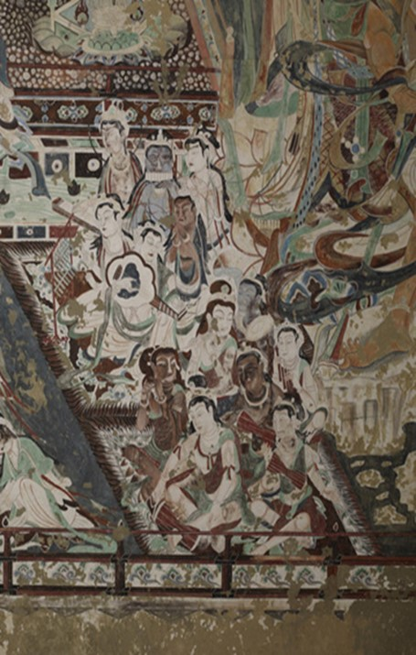
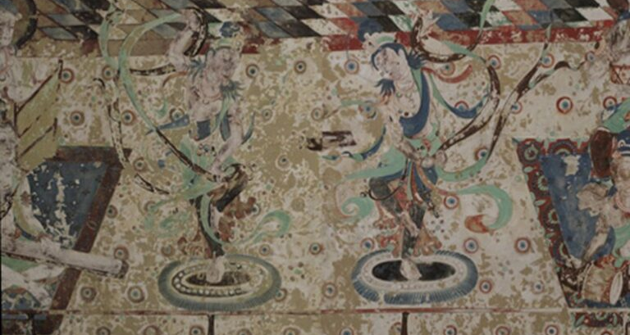
Cave 220

Slide 6
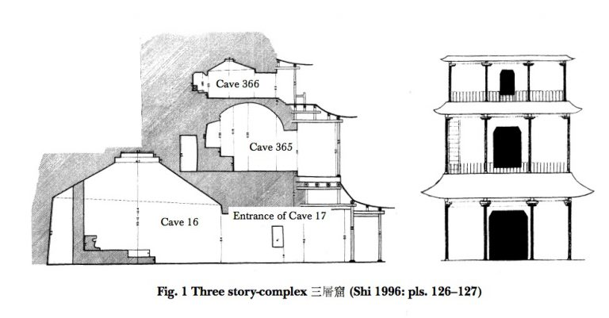
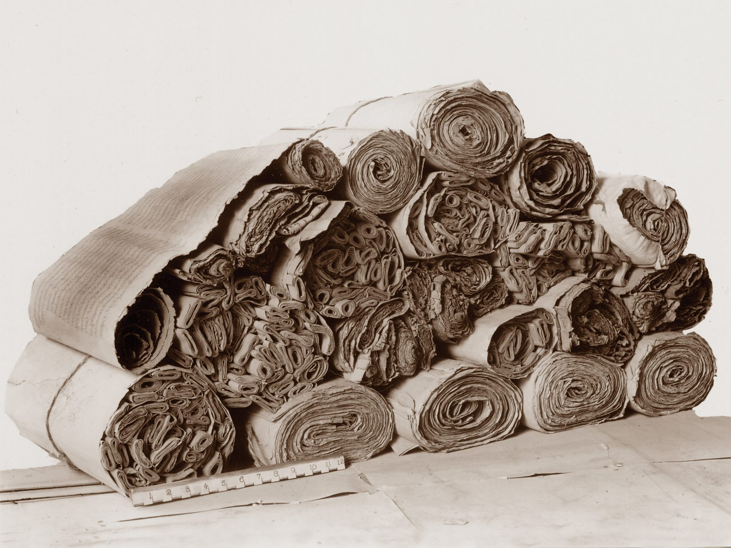
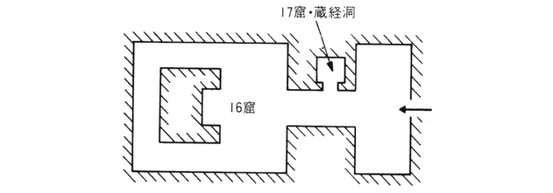

Slide 7
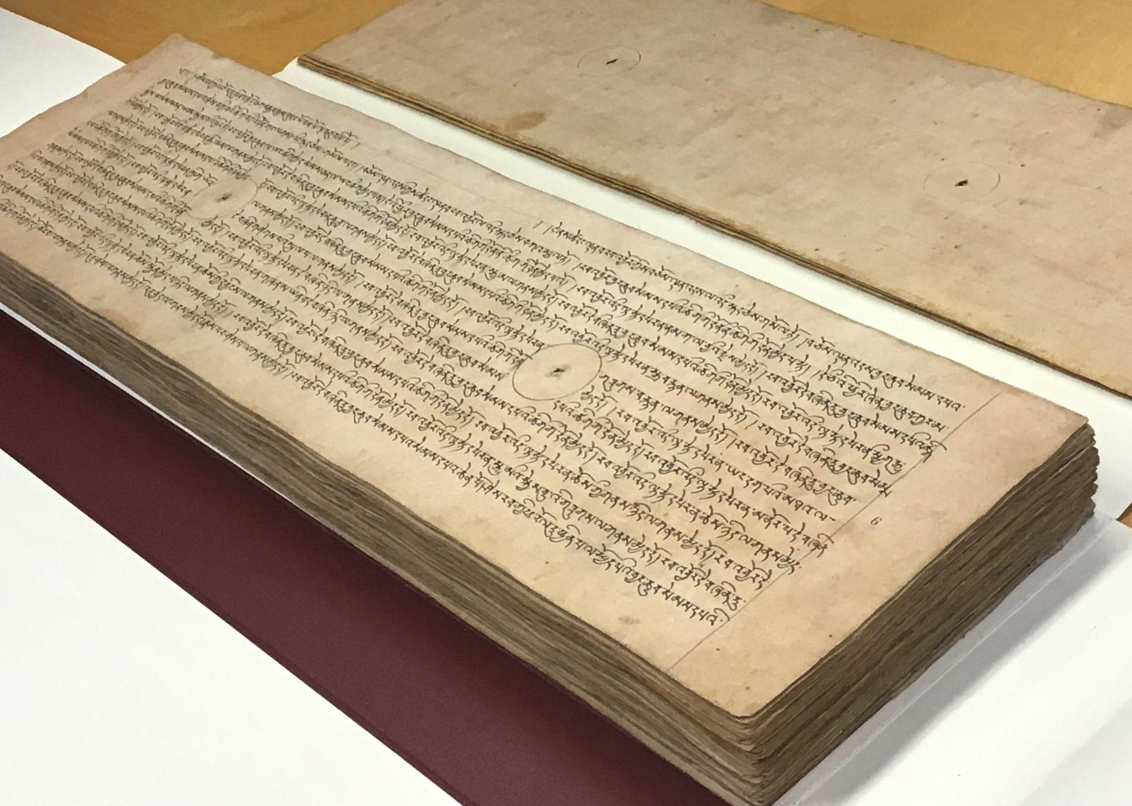
Concertina ^^
Pothi →
← Scrolls

Slide 8
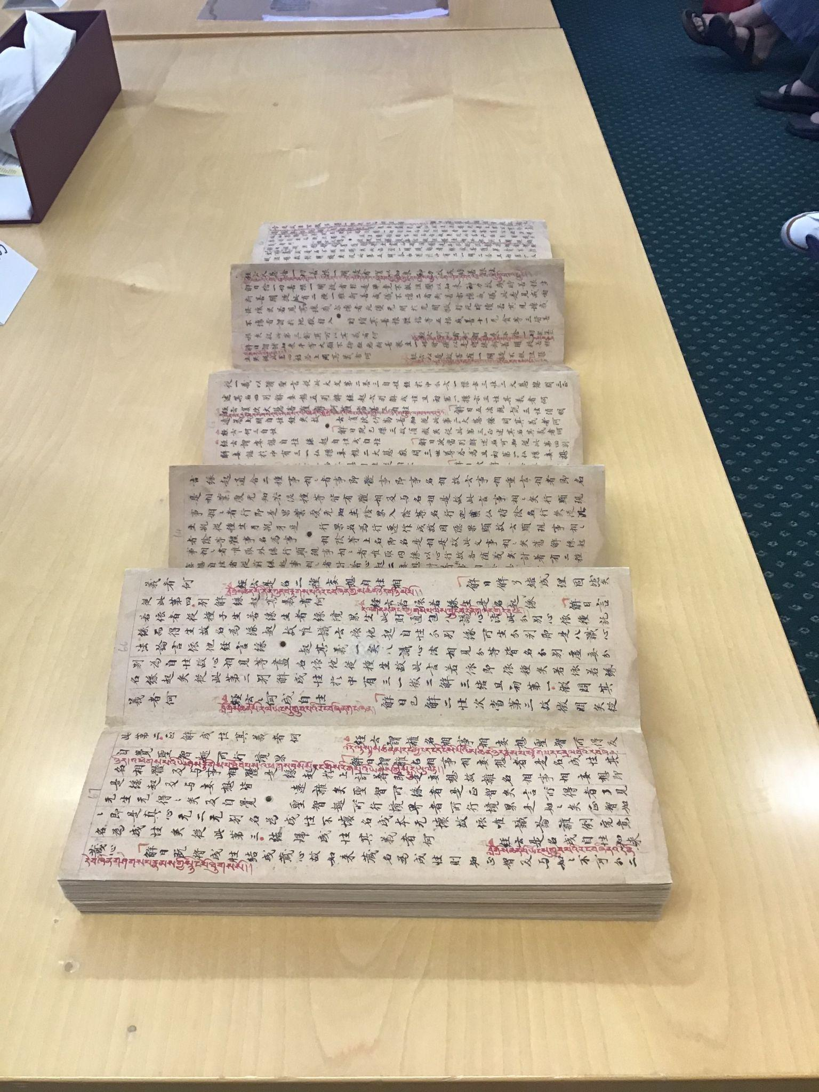
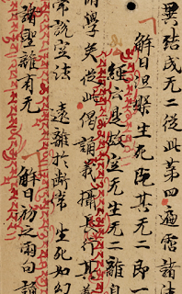
Cave 16/17
Exit Ticket:
What do you think scholars call this cave?

Slide 9
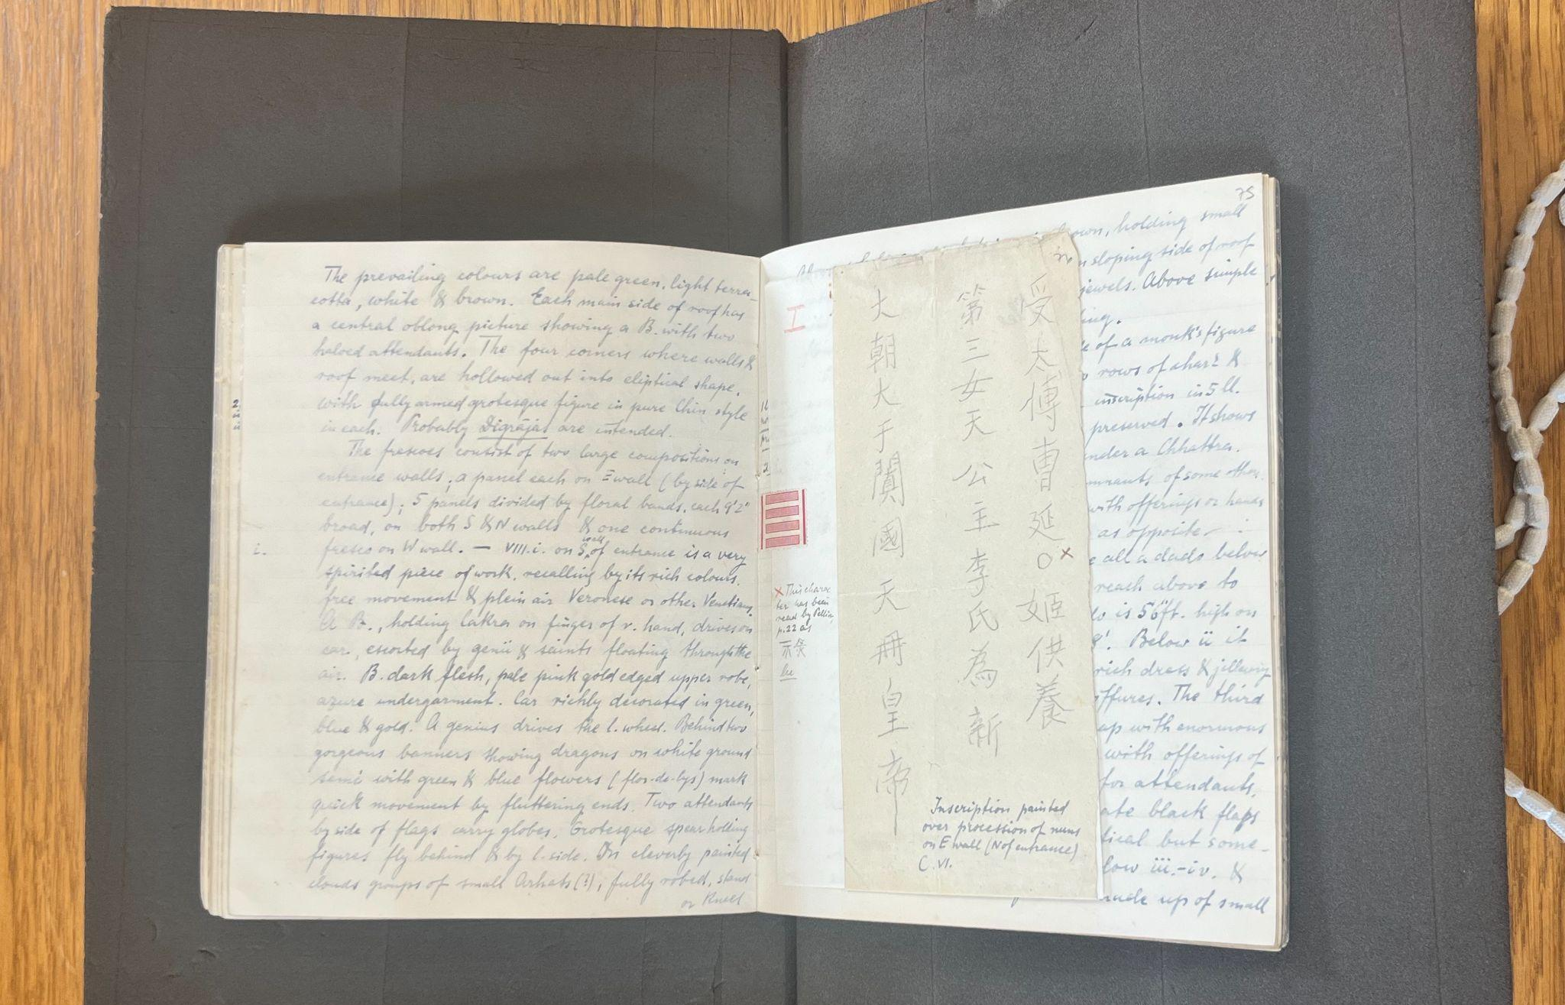
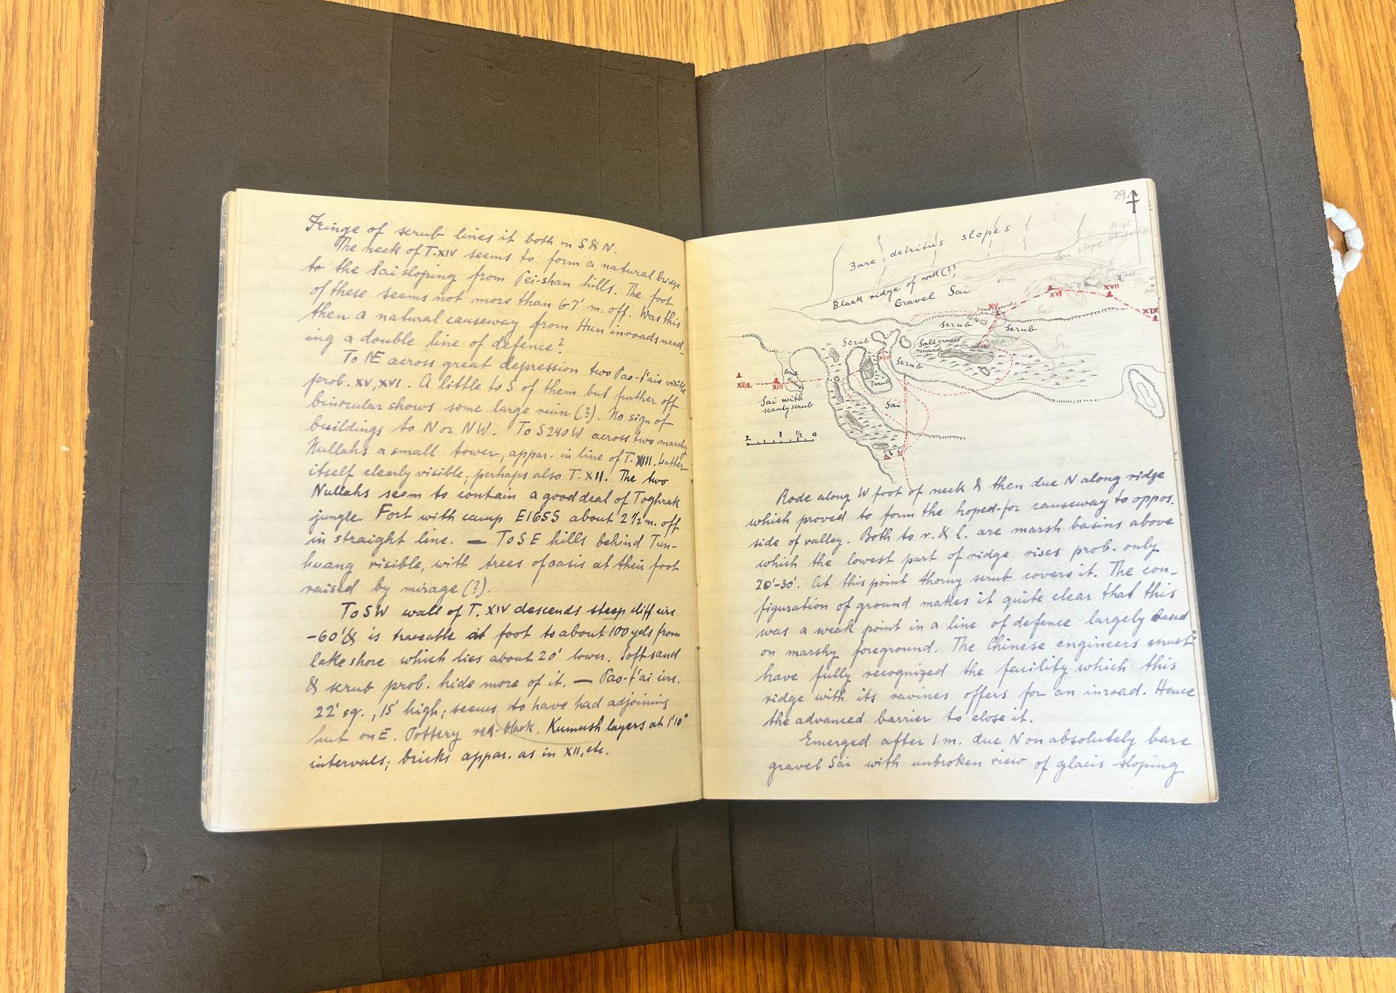
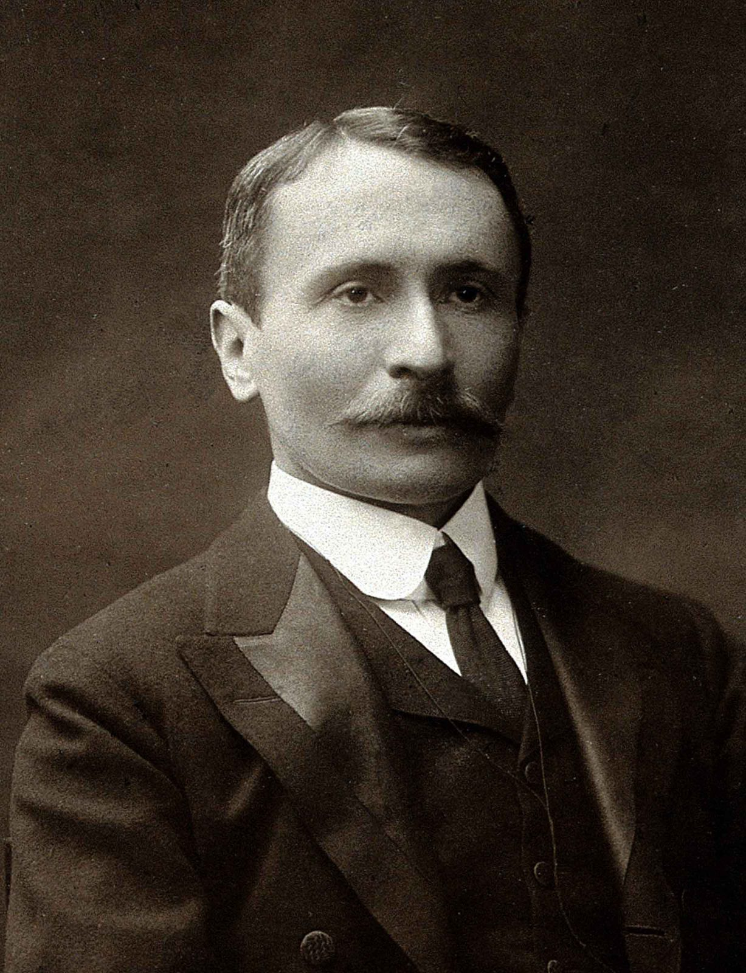
Quick Write:
Would you let someone take pictures of your diary!? Why or why not? Would there be a situation where you would?
Marc Aurel Stein

Slide 10
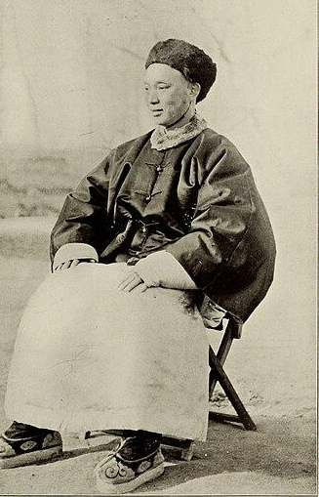
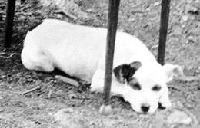
Jiang Xiaowan
Dash the Great (II)

Slide 12
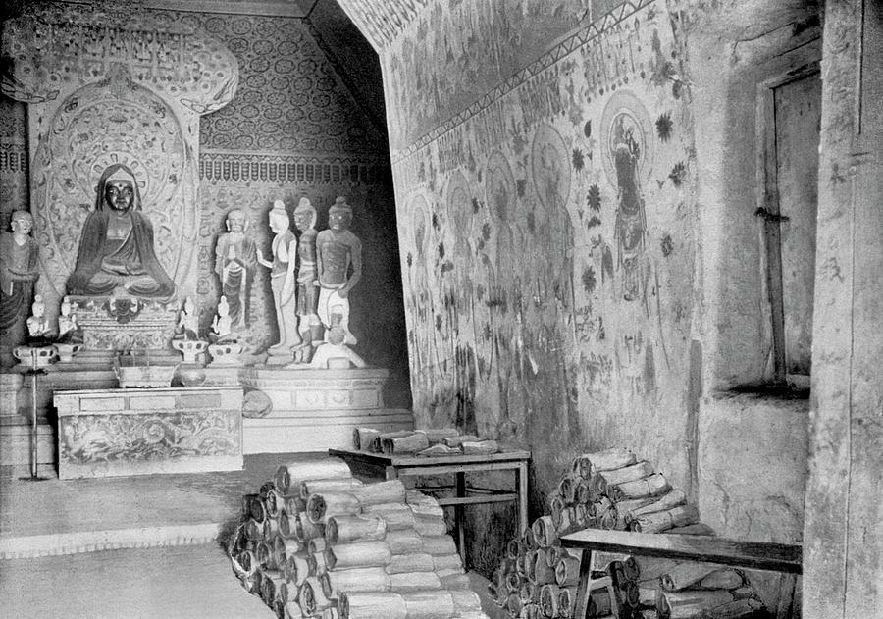
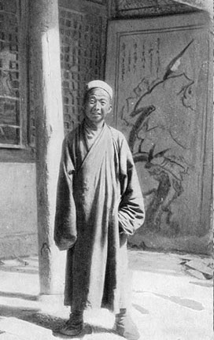
Wang Yuanlu
June, 1900

Slide 13
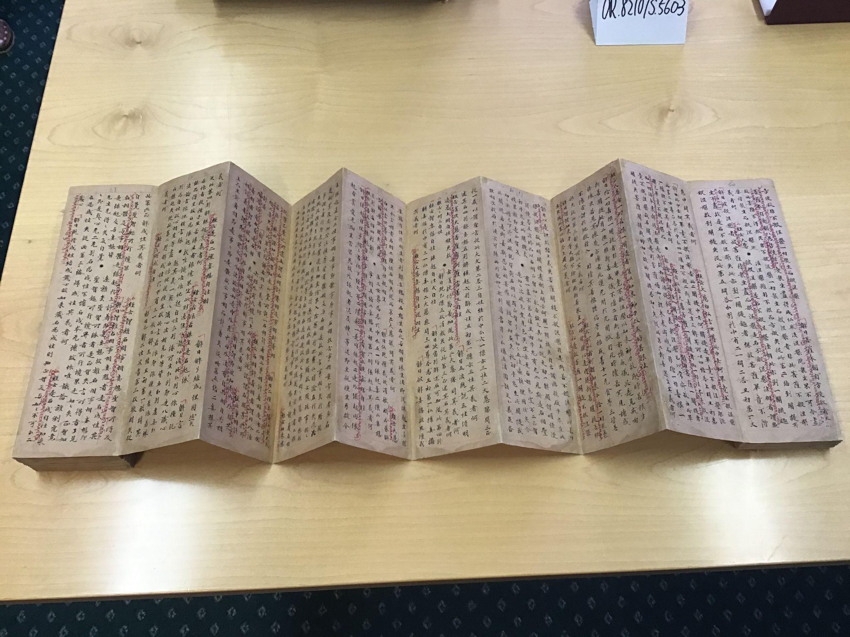
What do you notice?
What do you wonder?

Slide 14
Lankavatara Sutra
Tibetan Sutra
Chinese Commentary
Direction to
read Tibetan
Direction to read Chinese
“Thus have I heard…”

Slide 15
Concertina - Fold into 6 vertical columns
Listen and Draw #1 | Response and Commentary |  | Chinese Musical Instruments | Music Theory | Listen and Draw #2

Slide 16
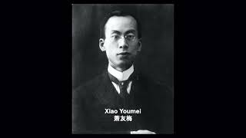
Concertina - Listen and Draw #1
Listen and Draw #1 (4 mins)
Draw a scene or a story that comes to mind as your listening.
Move your pencil to the music to create abstract shapes and patterns. Think about how your drawing is a response to the music

Slide 17
Listen and Draw #1 Pair Share
Draw a scene or a story that comes to mind as you’re listening.
Sentence Starter:
When the music sounded ______I thought of __________.
Move your pencil to the music to create abstract shapes and patterns. Think about how your drawing is a response to the music
Sentence Starter:
When the music sounded __________ I drew _________.

Slide 18
Concertina - Response and Commentary
Listen and Draw #1 | Response and Commentary What do you notice about this section? |  | Chinese Musical Instruments | Music Theory | Listen and Draw #2

Slide 19
Concertina - Response
Response and Commentary 4-5 Sentences
Scene or a story
Sentence Starter:
When the music sounded _____I thought of ______.
Shapes and patterns.
Sentence Starter:
When the music sounded _______ I drew ______.
Musical Vocab: tempo (fast/slow), pitch (high/low), beat/rhythm, phrasing, instruments

Slide 20
Concertina - Commentary
Response and Commentary 1/3 Swap
Swap papers with your partner.
👀 Look at your partner's image.
📖 Read what your partner wrote.
Underline 3-4 spots in their writing that you are going to comment on.

Slide 21
Concertina - Commentary
Response and Commentary 2/3 Rotate
2) Rotate your concertina 90°

Slide 22
Concertina - Commentary
Response and Commentary 3/3 3-4 Sentences
3) Comment on your partners work.
Examples:
Ask a question
I wonder _________
Add new information
I think ___________
Make a connection
I also thought of ______

Slide 23
Concertina - Pause and Reflect
Listen and Draw #1 | Response and Commentary Pair Share
Share your comments.
What was similar about your drawings and responses?
What was different?

Slide 24
Concertina
Listen and Draw #1 | Response and Commentary |  | Chinese Musical Instruments Re-listen AND watch Pipa Dizi Guqin Drum | Music Theory La Pentatone la’ so mi re do la | Listen and Draw #2 Ai Hai Yo By Tyler Arcari

Slide 25
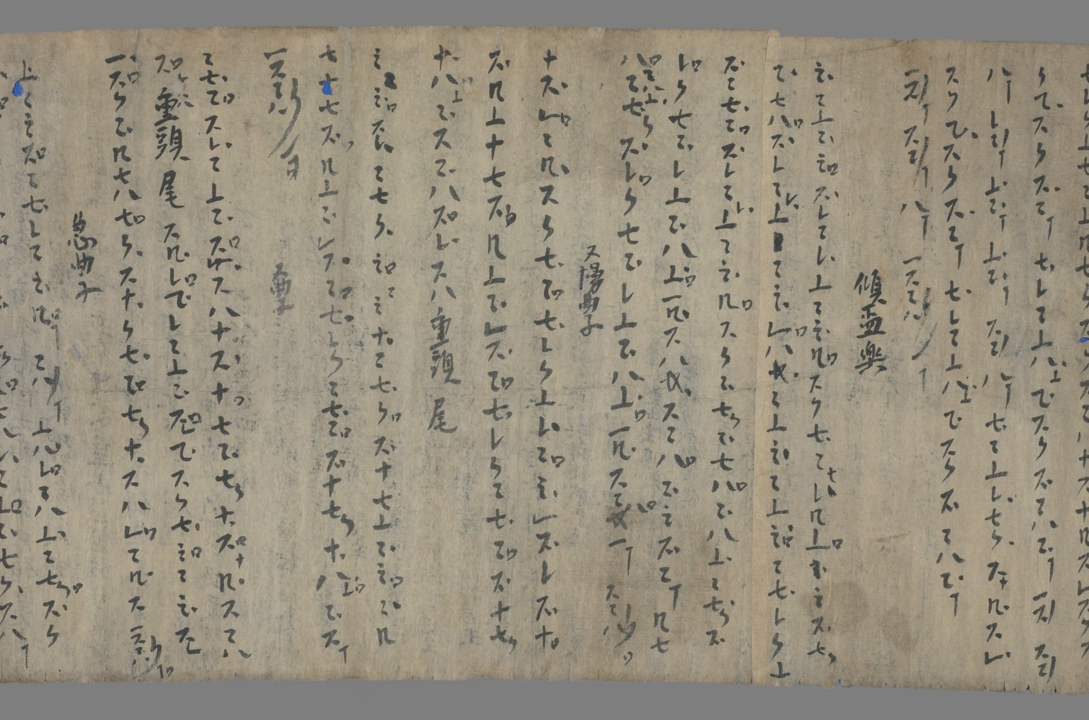
Pipa tablatures found in Cave 17
On the back of Buddhist sutras
No one knows what they sounded like, so scholars are trying to reconstruct the music from the scores
Ended up in France (Pelliot)

