Slide 1
From the Silk Roads, to London, to my School Library & Beyond
Join me on this journey!
01
Introduction
03
05
Acquired
Knowledge
Expectations
& Objectives
07
06
Assessment
04
Supplementary
Materials
02
Application
Lesson
Notes:
"This is how I would teach a lesson, here is how I would want to transfer ONE of the skills I learned"
Looked at every content area and how the knowledge can be taught
What is the message I would like to send?
Formation of library programming
Paper on the Silk Road

Slide 2
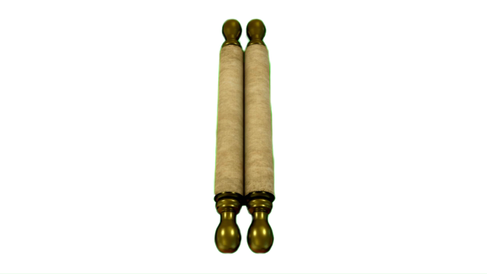
Introduction
What did I learn?
What did I learn?
Interconnected themes:
The cross-cultural exchange & transference of knowledge
The need for human connections & resources
Being resourceful in times of need or scarcity
Accessibility

Slide 3
From the Silk Roads, to London, to my School Library & Beyond
Join me on this journey!
Introduction
03
05
Acquired
Knowledge
Expectations
& Objectives
07
Assessment
04
06
02
Application
Supplementary
Materials
Lesson
Notes:
"This is how I would teach a lesson, here is how I would want to transfer ONE of the skills I learned"
Looked at every content area and how the knowledge can be taught
What is the message I would like to send?
Formation of library programming
Paper on the Silk Road

Slide 4
Lesson
PAPER ON THE SILK ROAD
How a Propitious New Technology Accelerated Cross-Cultural Connections & Information Accessibility
(Lesson adapted for History/Social Studies class simulation)

Slide 5
PAPER ON THE SILK ROAD
ME
How a Propitious New Technology Accelerated Cross-Cultural Connections & Information Accessibility
“I am a scribe, I’m looking for:
the best tools
the best method and
the best material
to use to spread my precious knowledge with the world.”
Everyone will have access to basic household items and resources.
Student research questions:
What would an 11th Century home near Dunhuang look like?
Where would I find this information?

Slide 6
From the Silk Roads, to London, to my School Library & Beyond
Join me on this journey!
Introduction
03
05
Acquired
Knowledge
Expectations
& Objectives
07
Assessment
04
06
Application
Supplementary
Materials
Lesson
Notes:
"This is how I would teach a lesson, here is how I would want to transfer ONE of the skills I learned"
Looked at every content area and how the knowledge can be taught
What is the message I would like to send?
Formation of library programming
Paper on the Silk Road

Slide 7
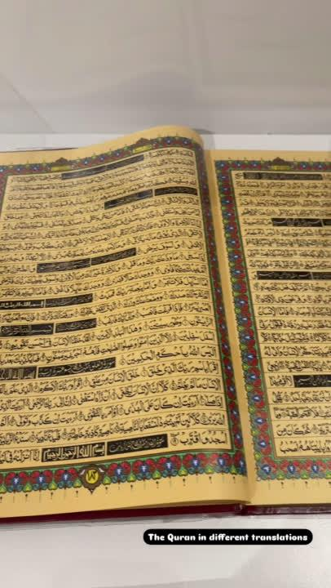
The cross-cultural exchange
& transference of knowledge
The need for human connections & resources
Acquired
Knowledge
Multilingual coins, Dr. Osmund Bopearachchi, the need to trade with neighboring countries, conquered cultures
Kapchin leader who wore the clothing of various cultures
Translations of various sacred texts:
Aga Khan’s collection of Qu’rans transcribed in Hebrew, English, etc.
History of the Royal Asiatic Society, scholars who translated books and more!
Accessibility
Being resourceful in times of need or scarcity
Paper as a new technology made information readily available and accessible for anyone
Modern accessibility: creation of the IDP website & the digitization of these materials
Recycled materials - paper and items for other uses
Wooden sticks used
to document & to...
clean oneself

Slide 8
From the Silk Roads, to London, to my School Library & Beyond
Join me on this journey!
Introduction
Acquired Knowledge
05
Expectations
& Objectives
07
Assessment
04
06
Application
Supplementary
Materials
Lesson
Notes:
"This is how I would teach a lesson, here is how I would want to transfer ONE of the skills I learned"
Looked at every content area and how the knowledge can be taught
What is the message I would like to send?
Formation of library programming
Paper on the Silk Road

Slide 9
Application
How Will I Use What I Learned?
Transfer + Exchange of Knowledge
Create library programming that can be applied to lessons for your class, regardless of subject
Library programming that builds on student’s knowledge obtained in class
Ultimate goal is to transfer this knowledge to our students so they can apply these new skills into different areas
Notes:
In this slide:
Describe my role as the School Librarian at LBMS
Departments, Clubs & School Events

Slide 10
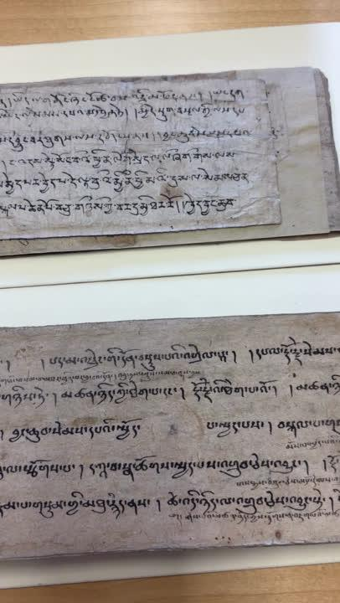
PAPER ON THE SILK ROAD
How a Propitious New Technology Accelerated Cross-Cultural Connections & Information Accessibility
Being Resourceful
Library Programming:
Host a papermaking workshop on our school’s World History Day
Led by students in Journaling Club
Promote recycling culture established at Luther:
Use cardboard, used printer paper
Leads into another lesson:
BOOKBINDING!

Slide 11
PAPER ON THE SILK ROAD
How a Propitious New Technology Accelerated Cross-Cultural Connections & Information Accessibility
The Need for Human Connections & Resources
History/Social Studies lesson simulation:
Lack of resources, what do you have to offer?
Maybe knowledge & skills?
Importance of communication and relationships:
Human connections - culture and language awareness

Slide 12
PAPER ON THE SILK ROAD
How a Propitious New Technology Accelerated Cross-Cultural Connections & Information Accessibility
Accessibility
Why was paper such an important innovation?
Continuing need for accessibility
Creating resources and easy access to information
Need to share knowledge

Slide 13
From the Silk Roads, to London, to my School Library & Beyond
Join me on this journey!
Introduction
Acquired Knowledge
05
Expectations
& Objectives
07
Assessment
06
Application
Supplementary
Materials
Lesson
Notes:
"This is how I would teach a lesson, here is how I would want to transfer ONE of the skills I learned"
Looked at every content area and how the knowledge can be taught
What is the message I would like to send?
Formation of library programming
Paper on the Silk Road

Slide 14
Expectations & Objectives
Knowledge a student must know to fully understand the material in this activity:
6th Grade Background Knowledge:
6.2.9. Trace the evolution of language and its written forms.
6.5.5. Know the life and moral teachings of Buddha and how Buddhism spread in India, Ceylon, and Central Asia.
6.5.7. Discuss important aesthetic and intellectual traditions (e.g., Sanskrit literature, including the Bhagavad Gita; medicine; metallurgy; and mathematics, including Hindu-Arabic numerals and the zero).
6.6 Students analyze the geographic, political, economic, religious, and social structures of the early civilizations of China.

Slide 15
PAPER ON THE SILK ROAD
How a Propitious New Technology Accelerated Cross-Cultural Connections & Information Accessibility
Just ONE example of a lesson adapted for a 6th grade History/Social Studies class.
Upper level:
Intro to Environmental Archaeology - research focused lesson
Lessons adapted for another subject will look different
ex: Science
Will it Paper? - focus on the scientific method, experimenting on what materials might make the best paper.

Slide 16
Departments at LBMS:
Math
Science
English Language Arts
History/Social Studies
Electives:
Visual Arts
Culinary Arts
Catering
Foods, the Environment & Culture
Exploring Tech
Exploring Engineering
Band & Orchestra
My Role at LBMS:
Basic library services:
Manage & supervise the library
Circulation & collection management
Library programming
Student support:
Access to physical & e-materials
Teacher support:
Resource guides for specific lesson
Reading lists, Text sets
Oversee a couple of clubs at the library
Kimberly Villalba, MLIS
Luther Burbank Middle School
School Librarian
& MORE!
Some of the Clubs at our school library:
Slime Bakery Club
Library Buddies
Journaling
Library Lunch Assistants
Events:
Monthly Holidays/Observations
PTSA DEI Committee Activities
World History Day
Questions I Always Ask Everyday:
How can I best serve my school’s community today?
What are the best & relevant resources & tools?
What can I do to make library services more inclusive & adaptable for all?
Over 1000 students!
Notes:
In this slide:
Describe my role as the School Librarian at LBMS
Departments, Clubs & School Events

Slide 17
From the Silk Roads, to London, to my School Library & Beyond
Join me on this journey!
Introduction
Acquired Knowledge
Expectations
& Objectives
07
Assessment
06
Application
Supplementary
Materials
Lesson
Notes:
"This is how I would teach a lesson, here is how I would want to transfer ONE of the skills I learned"
Looked at every content area and how the knowledge can be taught
What is the message I would like to send?
Formation of library programming
Paper on the Silk Road

Slide 18
Supplementary
Materials
What tools can we use or need?
Google Site that will serve as a resource guide for all.
Lesson plan on paper adapted for your classroom.
Videos and links to additional resources.
A database of paper knowledge

Slide 19
From the Silk Roads, to London, to my School Library & Beyond
Join me on this journey!
Introduction
Acquired Knowledge
Expectations
& Objectives
07
Assessment
Application
Supplementary
Materials
Lesson
Notes:
"This is how I would teach a lesson, here is how I would want to transfer ONE of the skills I learned"
Looked at every content area and how the knowledge can be taught
What is the message I would like to send?
Formation of library programming
Paper on the Silk Road

Slide 20
Assessment
What do we need to add, what areas need to improve?
Direct Feedback
Students - how can they use new skills & knowledge?
Teachers - did the activity and lesson complement your classroom?
Surveys
Threading project - program success

Slide 21
End of Expedition
Thank you for your time & participatiom!

